Slide 1

Tiktok Addictive Algorithm Unraveling Its Effects on Short-Term Memory
(Survey , the staticall chart , table )

Slide 2
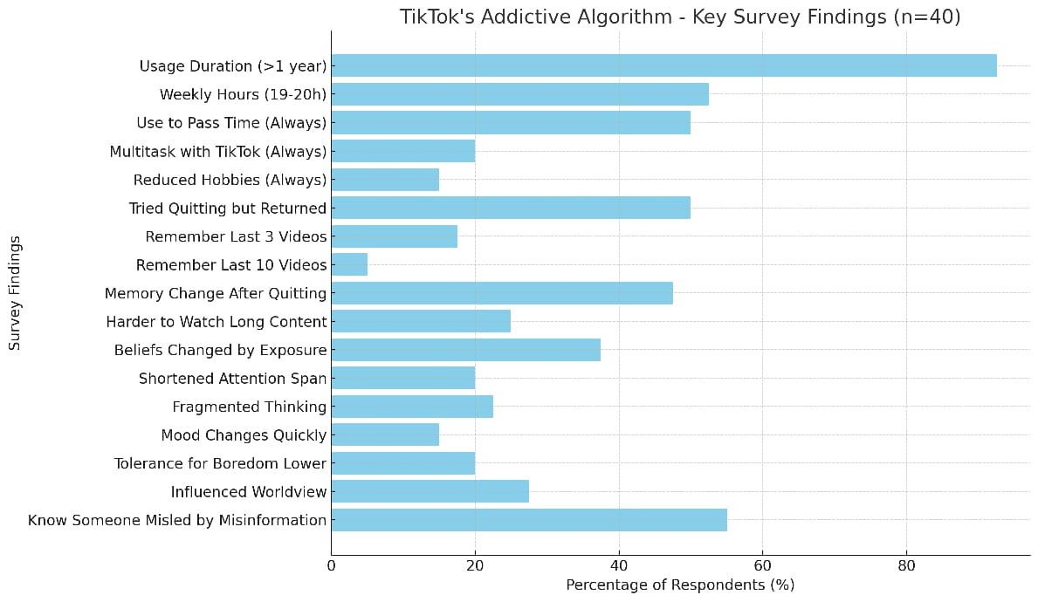

Slide 3
Used TikTok for more than one year | 92.5
Spent 19–20 hours per week on TikTok | 52.5
Able to recall last 3 videos watched | 17.5
Difficulty remembering details from lectures or books | 35
Know someone influenced by misinformation on TikTok | 55
Mean | 50.5
Maximum | 92.5
Minimum | 17.5
Standard Deviation | 27.91728855
Tiktok Addictive Algorithm – statistical tables

Slide 4
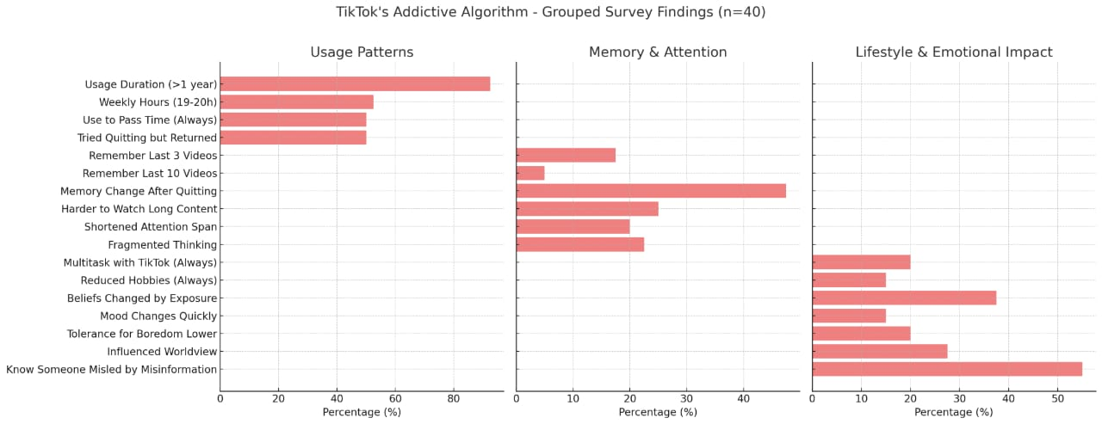
Tiktok Addictive Algorithm –grouped survary finding

Slide 5
This study is voluntary and anonymous.By continuing you confirm that you are 18 or older, agree to participate, and permit anonymous use of your responses for research
40 responses
I totally agree to be part of this
38 (95%
I don't wanna be
part of this
3 (7.5%)
0
20
40

Slide 6

1- Age
40 responses
Under 18
3 (7.5 | %)
31 (77.5
6 ( 1 (2.5%) | 15%)
+18
%)
+35
+50
0
20
40
2- Gender
40 responses
Female
22 (55%)
Male
18 (45%)
0
20
40

Slide 7
3- Are you currently an active TikTok user or any other social(used TikTok at least once in the last 3 days)
40 responses
1 (2.5%)
Yes
40 (1
No
0
20
40
4- How long have you been using TikTok
40 responses
Months (up to 1
year)
4 (10%)
Years
37 (92.5
0
20
40
5- How often do you open TikTok just to pass time” without a specific purposes"
40 responses
47.5%
Sometimes Always
Never
50%

Slide 8
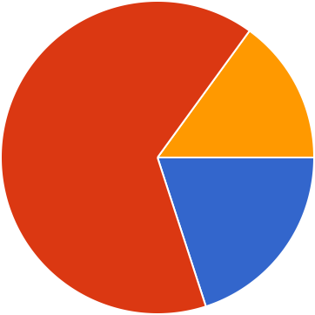
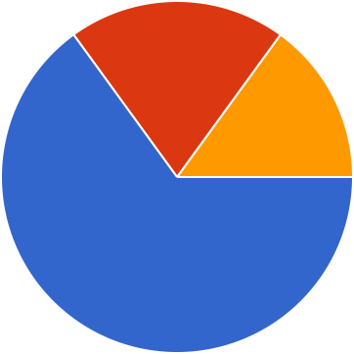
6- How many times per day do you open TikTok?
40 responses
2h to 4h 5h to 8h 9h to 18h 19h to 20h
30%
10%
7.5%
52.5%
7- Do you ever use TikTok while doing other tasks (studying, eating, in class/work )
40 responses
Always Sometimes Never
15%
65%
20%
8-Do you ever fell like using TikTok, made you spend less time on your hobbies and physical activity
40 responses
20%
Always Sometimes Never
15%
65%

Slide 9

9- have you ever made a promise to yourself to delete tiktok but end up using it again because you feel it has become a part of your day
40 responses
50%
Yes No
50%
10- Short length of videos makes it easy to watch one more
40 responses
Yes No
12.5%
87.5%
11- Do you ever feel like you don't even like what you see but you keep scrolling anyway
40 responses
Yes No
12.5%
87.5%

Slide 10

12- Have you ever felt like tiktok reads your mind
40 responses
Yes No
10%
90%
13- Have you ever used the repost feature to express how you feel towards someone instead of communicating with them directly
40 responses
Yes No
32.5%
67.5%
14- Do you remember the last 3 videos you saw on your for you page
40 responses
Yes No
82.5%
17.5%

Slide 11
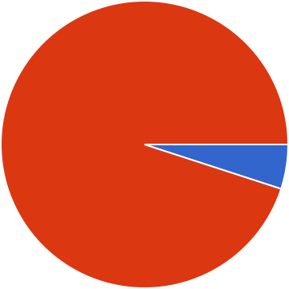
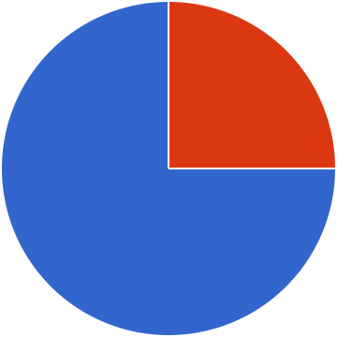

15- Do you remember the last 10 videos you saw on your for you page
40 responses
Yes No
95%
5%
16- Have you noticed any quick changes in your memory after stopping TikTok use
40 responses
47.5%
Yes No
52.5%
17- Do you feel it has become harder for you to watch lectures or movies, or any videos longer than one hour, in general
40 responses
Yes No
25%
75%

Slide 12
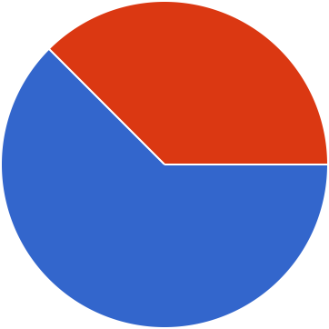
18- Have you ever experienced your TikTok For You page showing videos on a topic you recently discussed in conversation
40 responses
37.5%
Always Sometimes Never
10%
52.5%
19- Do you remember how many TikTok videos you watch in a day
40 responses
10%
It's uncountable Yes
No
15%
75%
20- Have your personal beliefs ever changed because repeated content on TikTok made certain ideas seem more acceptable
40 responses
Yes No
37.5%
62.5%

Slide 13
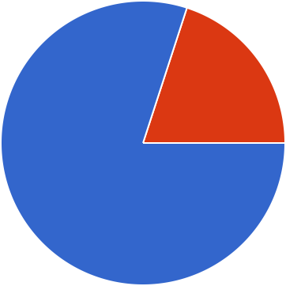
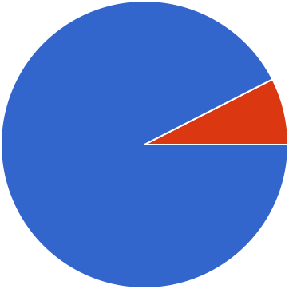
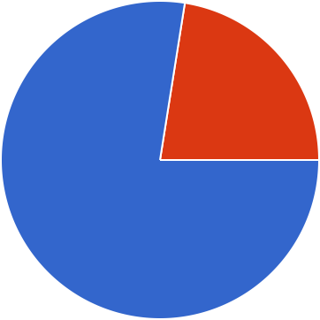
21- do you think your attention span has shortened due to the rapid pace and frequent content changes in short videos
40 responses
Yes No
20%
80%
22- Do you feel impatient when content takes longer to get to the main point
40 responses
Yes No
7.5%
92.5%
23- Do you think short videos have made your thinking more fragmented or jumpy
40 responses
Yes No
22.5%
77.5%

Slide 14

24- Have you noticed that you seek instant results or quick answers more often
40 responses
Yes No
20%
80%
25- Do you feel you become less productive
40 responses
Yes No
22.5%
77.5%
26-Does short videos change your mood quickly from bored to excited or happy to sad
40 responses
Yes No
15%
85%

Slide 15
27- Have you noticed your tolerance for boredom decreasing since using short-form video apps
40 responses
Yes No
20%
80%
28 - Does watching short videos made it harder for you to remember details from lectures, books, or conversation
40 responses
Yes No
35%
65%
29- Do you feel that repeated exposure to certain ideas or lifestyles in short videos has influenced your worldview
40 responses
Yes No
27.5%
72.5%

Slide 16
30- Do you know anyone who has been affected or scammed by false medical information on TikTok
40 responses
37.5%
Yes No
Well I'm one of them
7.5%
55%

